Slide 1
CSS Layouts
Front-End Web Development

Slide 2
Lesson 03 Change Log FEWD 3.1 - 3.2
Below are the specific changes made in this lesson.
Returning Instructor Directions:
Click on the hyperlinks below, and it will direct you to the specific slide.
Copy the entire slide, and paste in your existing curriculum deck.
Pre-Class Materials and Preparation - Added warmup activities to the new CodePen collection “Warmups”.
Share how the lesson went through our Instructor Lesson Exit Ticket - the Curriculum Feedback form: http://ga.co/curriculum-feedback

Slide 3
Pre-Class Materials and Preparation
Review all slides, lab activities, and code-alongs.
There are prompts in the speaker notes with opportunities for instructor customization.
Materials
Reference Code
Starter Code in CodePen
Solution Code in CodePen
Warmups in CodePen

Slide 4
Box Model
Overview
This lesson introduces the box model, which drives CSS sizing and positioning rules.
Learning Objectives
In this lesson, students will:
Link to files from HTML using relative paths.
Apply normalizing CSS
Use margins and padding
Set the display property of elements to create page layouts.
Duration: 180 minutes

Slide 5
Suggested Agenda
Time | Activity | Purpose
0:00–0:30 | Linking Files | Introduce students to file structures in web development projects.
0:30–0:45 | Practice With Paths | Exercise linking techniques with local files. Useful for showing them how it "really" works outside of CodePen.
0:45–1:15 | Normalizing CSS/Structuring HTML | Reinforce the DOM tree and relationships between elements.
1:15–1:30 | How Is This Page Structured? | Practice wireframing based on existing websites. Establish the idea of container elements that may not have actual borders/backgrounds but are for layout purposes.
1:30–2:00 | The Box Model | Emphasize the role of margins and padding in defining content space, along with display for layout rules.
2:00–3:00 | Practicing the Box Model | Build a page layout using box model properties. Be sure to support each team/group throughout this exercise. You may encourage groups instead of partners if students are struggling.

Slide 6
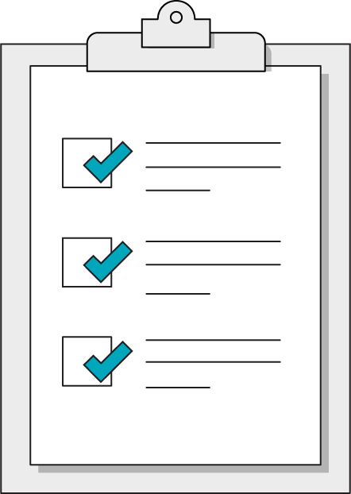
Today’s Learning Objectives
In this lesson, you will:
Link to files from HTML using relative paths.
Apply normalizing CSS to avoid browser default styling interference.
Use margins and padding to create spacing between elements.
Set the display property of elements to create page layouts.
‹#› | © 2020 General Assembly
Notes:
DURATION: 1 minute
TEACHING TIPS:
Learning objectives help frame the lesson and give students an idea of what to expect and focus on.
Explain to students how this lesson fits into the overall course to help them make connections with content from other lessons.

Slide 7

Quick Review
What are the two major types of HTML tags?
What are the three parts of a CSS declaration?
What are some CSS selectors we’ve learned?
Who has explored some CSS properties since last class?
Notes:
TEACHING TIPS:
You can write down any properties volunteered from students on the board. If remote, create a Slack thread for each of the questions.
Reassure students that it’s OK if they didn’t!
Encourage them to keep trying new things — development is very practice-/project-based and the best way to know the concepts is by using them.

Slide 8
Cascading: What Does It Mean?
Front-End Web Development

Slide 9

Think of the Document Tree as a Real Tree
<main>
<section>
<div class=“green-font”>
Content A
</div>
<div>
Content B
</div>
</section>
</main>
DOM Tree
Real Tree
‹#› | © 2020 General Assembly
Notes:
TALKING POINTS:
Styles cascade through your document following basic “trunk” elements down to the “leaves.” A rule affecting the “tree” would naturally impact all of the leaves as well, while a rule targeting one specific leaf would miss the surrounding branches, the trunk of the tree, etc.

Slide 10
What If I Apply My Styles at Each of These Spots?
<div class=“leaves”>
<main>
‹#› | © 2020 General Assembly
Notes:
TEACHING TIPS:
Ask students if a rule written for <main> would affect <div>, and vice versa.
TALKING POINTS:
Look for natural groupings and common visual themes throughout websites — chances are they are all defined by the same rule that has been given a broad-enough selector to impact all elements with that style.

Slide 11
<main> Styles the Whole Tree — .leaves Styles a Small Leaf
<div class=“leaves”>
<main>
‹#› | © 2020 General Assembly

Slide 12
Classes & IDs
Front-End Web Development

Slide 13
Class & ID
With classes and ids we can target specific elements on a page, so we can manipulate it uniquely.
Notes:
TEACHING TIPS:
This is just one answer to the previous slide’s question. If your class drew something different than this, that’s OK!
The content tags should have been much more agreeable than the container/semantic tags, which are where developers have to make more judgment calls on HTML elements.

Slide 14
Defining a Class or ID
Classes and IDs are defined as attributes
They must start with a letter
They can contain letters, numbers, the hyphen (-), and underscore (_)
<p class=”featuredText”>Many Products</p>
Class Name
Notes:
TALKING POINTS:
Attributes are additional information we add to an element. They appear in the opening tag of the element and are made of up two parts: a name and a value, separated by an “=” sign.
The attribute name indicates what kind of extra information you’re supplying about the element’s content.
The value is the information regarding the attribute.
The majority of attributes are unique to certain elements. One of these is the anchor element. Here, the href attribute gives us more information about the anchor — it tells the browser where to go when the user clicks on the text.
Additional resource: https://html-css-js.com/html/tutorial/html-tag-attributes.php

Slide 15
Defining a Class or ID
Classes and IDs are defined as attributes
Id’s are UNIQUE on a page
Classes can be used many times on a page
<p id=”theUsername”>GaiusMarius</p>
ID Name
Notes:
TALKING POINTS:
Attributes are additional information we add to an element. They appear in the opening tag of the element and are made of up two parts: a name and a value, separated by an “=” sign.
The attribute name indicates what kind of extra information you’re supplying about the element’s content.
The value is the information regarding the attribute.
The majority of attributes are unique to certain elements. One of these is the anchor element. Here, the href attribute gives us more information about the anchor — it tells the browser where to go when the user clicks on the text.
Additional resource: https://html-css-js.com/html/tutorial/html-tag-attributes.php

Slide 16
More Advanced Selectors
Front-End Web Development

Slide 17
Selectors Targeting Multiple Attributes
div.my-class {
color: white;
text-decoration: underline;
}
You can also combine several selectors together in order to target only the elements that match all of the selectors included. The example above targets only div elements with the .my-class class.
Notice that there is no space between div and .my-class.
‹#› | © 2020 General Assembly
Notes:
TEACHING TIPS:
Explain that a series of selectors that are connected without a space are all targeting the same element. The subtle difference between this and the parent selector can easily cause unintended behavior.

Slide 18
Specific selectors override general selectors:
ID > Class > Element
‹#› | © 2020 General Assembly
Notes:
TEACHING TIPS:
Also note that adding more specific targeting, such as parent selectors, combinators, or compound selectors like div.my-class, will also affect the specificity.
Reference this specificity calculator as a nice tool: https://specificity.keegan.st/.

Slide 19
!important
.make-it-white {
color: white !important;
text-decoration: underline;
}
Using !important makes this style jump out of the DOM tree order and take precedence over all other styles.
If you use this in your work regularly, code reviewers will not be happy. This is considered a brute-force, last-resort approach when all other selectors have failed.
‹#› | © 2020 General Assembly
Notes:
TALKING POINTS:
!important is the end game of the specificity rules conflict. Once you get more specific than an ID, things get dicey — using parent selectors can help make more specific rules when necessary.

Slide 20
CSS Exploration
30 minutes
This exercise is to practice writing specific selectors to apply styles. Remember, there’s more than one right answer!
Starter code:
https://drive.google.com/drive/folders/1K_Whx2c2PQK2QfQu7h9uyNjdLRaUSdRC?usp=sharing
Solution code:
https://drive.google.com/drive/folders/1K_Whx2c2PQK2QfQu7h9uyNjdLRaUSdRC?usp=sharing
‹#› | © 2020 General Assembly

Slide 21
CSS Exploration
30 minutes
In the exercise folder, open the README.md in Visual Studio Code for a list of specific styles to create
‹#› | © 2020 General Assembly

Slide 22
Structuring HTML
Front-End Web Development

Slide 23
The DOM Tree
A visual diagram of a webpage’s HTML structure.
Notes:
TEACHING TIPS:
This is a good time to review the term “DOM” and ask what relationships can exist between DOM elements: parents/children/siblings.

Slide 24
Tree-Like Structures Can Be Visualized
<main>
<section class=”ichi”>
<p>
Content
</p>
</section>
<section class=”ni”>
<p>
More content
</p>
</section>
</main>
p
section
p
section
main
Notes:
TALKING POINTS:
Note how <main> splits off into two “directions” with each section; sections could split off with several children as well, as each “branch” can itself have many branches.

Slide 25

How Is This Page Structured?
15 minutes
Notes:
TEACHING TIPS:
Split students into groups and give them dry erase markers. Have them wrestle with the problem.
In a remote class, let them know they have screenshare and marker tools in Zoom. They should be able to draw outlines over the image using screenshare.
The biggest area students struggle with is seeing the need for containers. This is a good bridge into how CSS works and box model — set it up and you’ll hook them.
If you’re using a projector and whiteboard, you could draw outlines around the parts of the page as students describe them. Once they’ve given each part an element, you can turn off the projector and reveal the HTML skeleton behind the site.

Slide 26
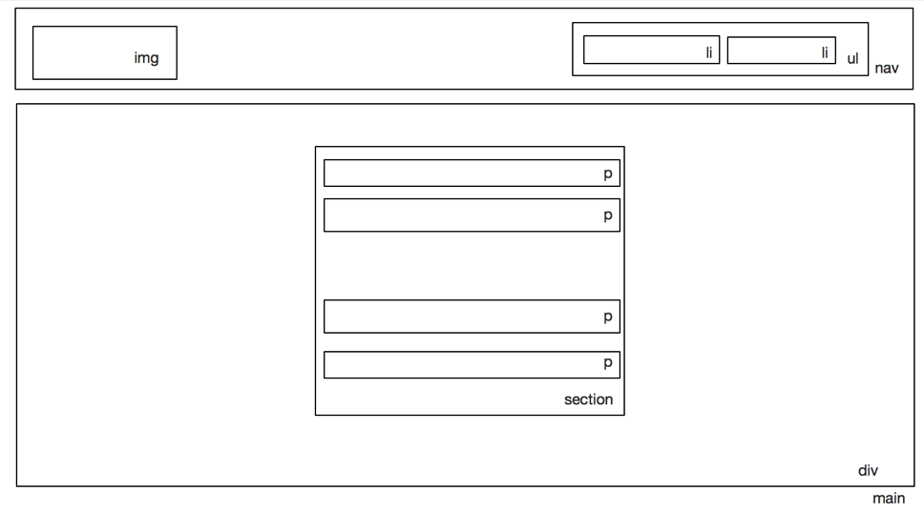
Remember: HTML Is Subjective (to Some Degree)
Notes:
TEACHING TIPS:
This is just one answer to the previous slide’s question. If your class drew something different than this, that’s OK!
The content tags should have been much more agreeable than the container/semantic tags, which are where developers have to make more judgment calls on HTML elements.

Slide 27
The Box Model
Front-End Web Development

Slide 28
CSS Box Model
As we discuss the details of the box model, you can reference the following CodePen for specific examples and illustrations of each concept:
Reference code:
https://drive.google.com/drive/folders/1VAZyify_6c48UlN4iKmBfIPh4AMYY6xM?usp=sharing

Slide 29
The Box Model
margin-top
border-top
padding-top
width
background-color
margin-left
border-left
padding-left
height
padding-right
border-right
margin-right
padding-bottom
border-bottom
margin-bottom
Notes:
TEACHING TIPS:
You should also open up Chrome Inspector on a website and reveal its box-model highlighting feature. Explain the colors behind the box model and how you can play around with the values right there in Inspector — hopefully students are getting used to using the Inspector frequently as they code!
You should also explain how margin/padding shorthand declarations go clockwise around the box — draw that out for the class.

Slide 30
Box Model Basics
Every element on a webpage is a box.
Elements have a padding, border, and margin.
width + padding + border = actual visible width of an element's box.
height + padding + border = actual visible height of an element's box.
margin is outside the box and does NOT count toward visible height and visible width.
margin-top
border-top
padding-top
width
margin-left
border-left
padding-left
height
padding-right
border-right
margin-right
padding-bottom
border-bottom
margin-bottom

Slide 31
CSS Display Property
Front-End Web Development
Notes:
TALKING POINTS:
You’ve already seen the display property in the previous example defining block and inline.
So far we’ve covered CSS rules that influence a single element. Now we’re moving on to CSS rules that influence how that element is placed within the broader context of the page and the relationships it has to nearby elements.

Slide 32
display
display controls the behavior of the box in which content sits. We’ll cover several of the most commonly used values of the display property:
block
inline
inline-block
none

Slide 33
Block vs. Inline Elements
Block-level elements fill the width content flow.
div, section, h1-h6, ul, ol, nav, header, footer
Inline-level elements do NOT fill the width nor have discrete margin.
a, span, img, button, sub, sup, b, em
You can apply display: block; to an inline element via CSS and it will become a block-level element (and vice versa).
Refer here for list of inline elements: https://developer.mozilla.org/en-US/docs/Web/HTML/Inline_elements
Notes:
TALKING POINTS:
Using Inspector is crucial for figuring out which elements are block versus inline when you’re first starting out. It can be tough to know!

Slide 34
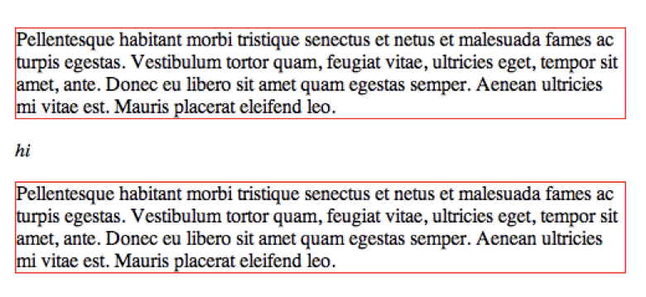
Positioning Elements: block
display: block;
This element takes up as much width as possible and the following element drops to a new line.
Image source; css-tricks.com

Slide 35
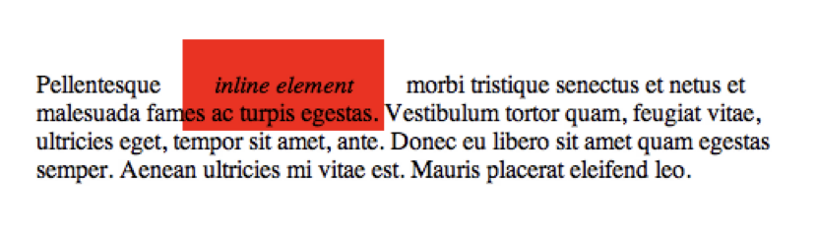
Positioning Elements: inline
display: inline;
This element takes up only as much width as it needs. Padding and margins only work for left and right, not top and bottom.
top and bottom spacing is controlled by the line-height property because the content is inline.
Image source; css-tricks.com

Slide 36
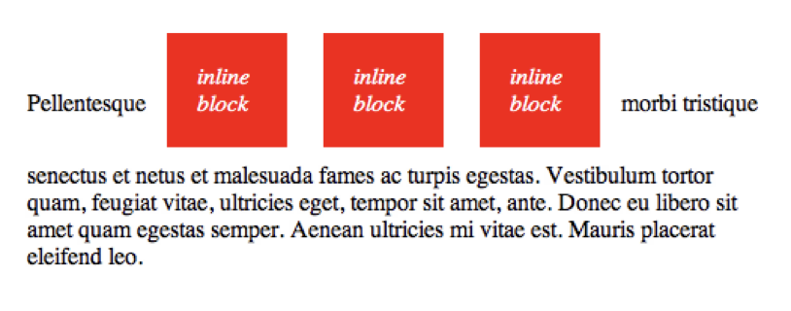
Positioning Elements: inline-block
display: inline-block;
This combines the two concepts.
Inline blocks display inline with other items but allow you to use all margin, padding, height, and width properties.
Image source; css-tricks.com

Slide 37

Positioning Elements: none
display: none;
Nothing shows up at all. It's in the DOM the browser sees, but the user won't see it. You can use Chrome DevTools to see the browser’s view.
This may seem useless now, but just wait until we hit JavaScript. You're going to love display: none.
Image source; css-tricks.com
Notes:
TALKING POINTS:
Question: If we don’t want something to be visible, why even put it in the HTML at all?
Answer: We can use JavaScript to turn it visible later on and do the opposite to hide elements by giving them display: none as well!

Slide 38
Normalizing CSS
Front-End Web Development

Slide 39

Normalizing Output
Browsers all have their own unique ways of rendering things.
Very smart people have compared and contrasted these very minor differences and fixed them for you — how nice!
There are many of these fixes, but we’ll make your life simple and point you to the most popular one, Normalize CSS: http://necolas.github.io/normalize.css/.

Slide 40
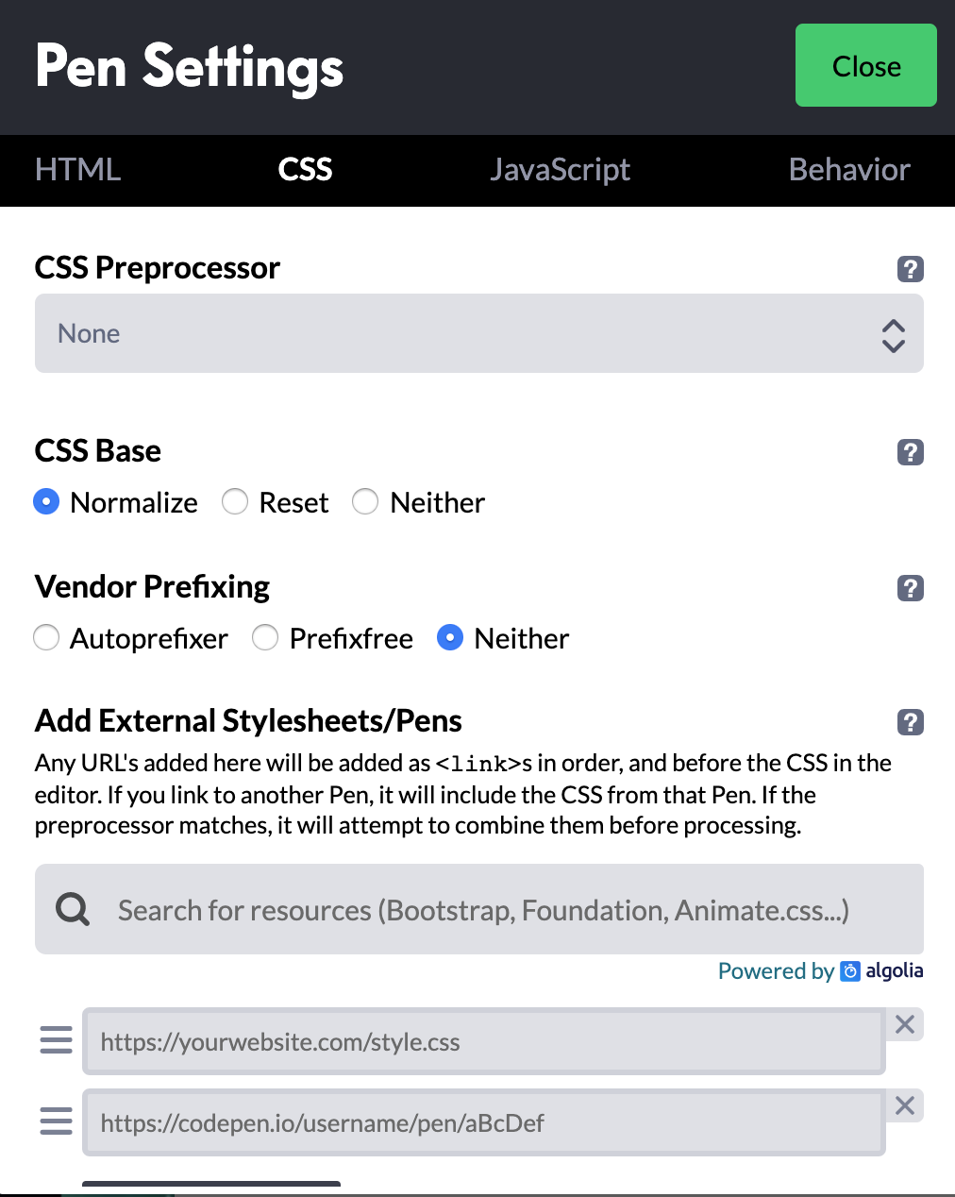
How to Use Normalize
<head>
<title>Something Unique</title>
<link rel="stylesheet" href="css/normalize.css">
<link rel="stylesheet" href="css/main.css">
</head>
Download Normalize.
Place Normalize CSS before your external CSS.
Code away like normal.
Note: In CodePen (see image), you use Normalize as a “CSS Base” by clicking the gear in the CSS panel.

Slide 41
Normalize vs. Reset
‹#› | © 2020 General Assembly

Slide 42
Use Normalize or Reset on this week’s homework!
‹#› | © 2020 General Assembly

Slide 43
Practicing the Box Model
60 minutes
Use what you have learned about the box model and selectors to create a style guide
Style guides are critical to all large scale projects
Open the project folder starter code: https://drive.google.com/drive/folders/1VAZyify_6c48UlN4iKmBfIPh4AMYY6xM?usp=sharing
The README.md file contains a list of necessary styles
Notes:
TEACHING TIPS:
This assignment may be beyond what students can do. Support them and make them push into new material. Again, this could be a partial code-along/self-guided activity.
The goal would be that they get a little frustrated and push into flexbox on their own. Weaker students may feel lost, but support a productive struggle. Potentially bring students together for code-alongs as they work through this. At this point, encourage exploration more than anything!

Slide 44
Key Takeaways
For Next Time
Display and the Box Model
Layouts With Flexbox
Block elements have three key properties affecting their size and spacing:
padding
margin
border
The display property is used to set elements next to or on top of each other.
Flexbox creates dynamic, responsive layouts.

